Slide 1
Data Science in Advertising: A future when we love ads
Soups Ranjan, PhD
@soupsranjan
April 10th, 2015

Slide 2
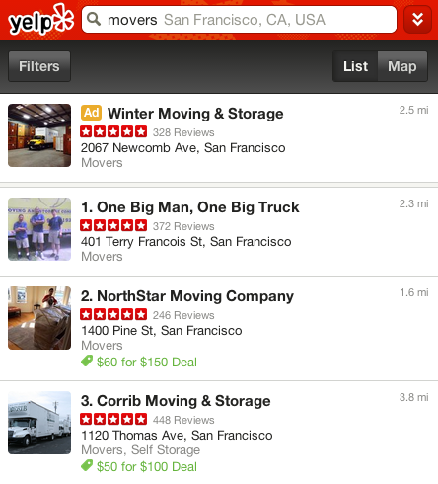
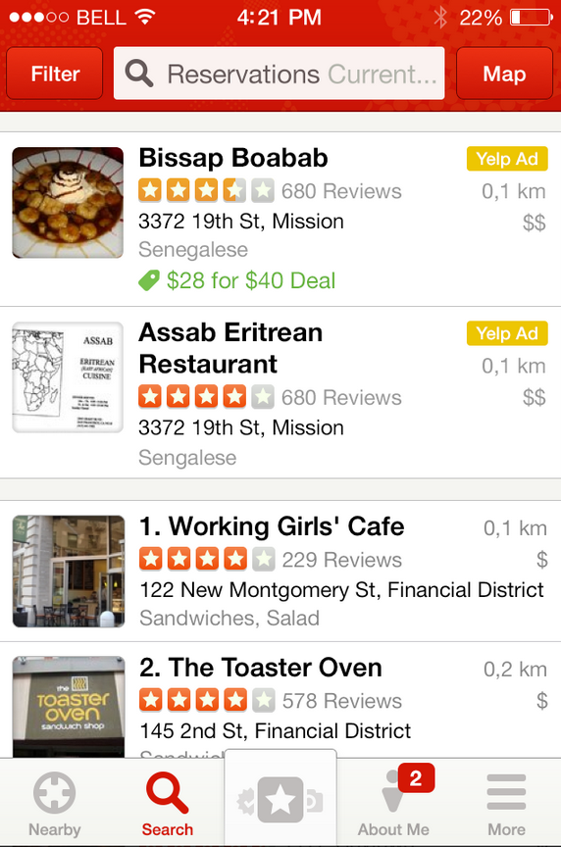
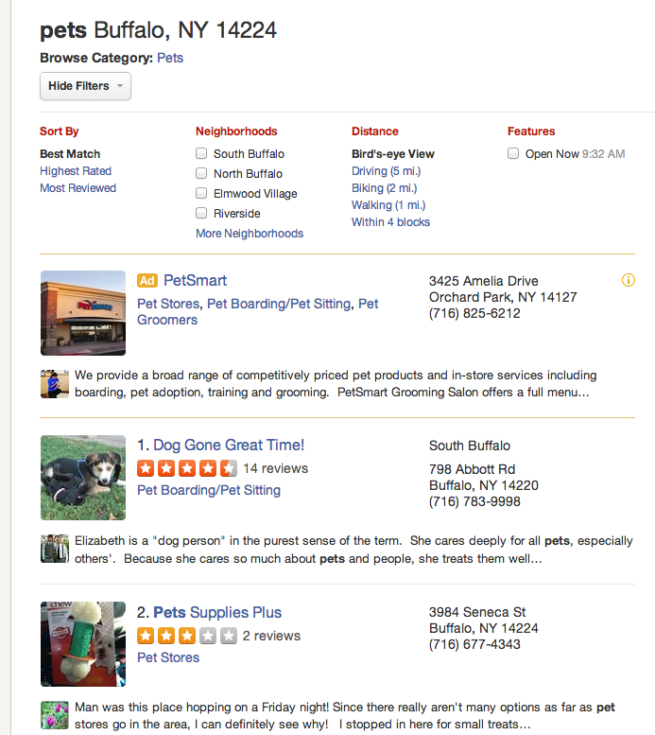
Where do our local ads show?
m.yelp.com
iOS, Android apps
www

Slide 3
Yelp Advertisers
“89% of users who research a business on Yelp make a purchase at that business within a week” – Yelp Q4 2014 Investor Deck
National as well as local businesses
professional services (movers, gardeners, plumbers), restaurants, etc.
Purchase many different ways:
Impression package on a CPM (Cost Per Impression) basis
Clicks on a CPC (Cost Per Click) basis
Leads on a PPC (Pay Per Call) basis
Packages:
CPM: $350 per month for 1,000 impressions
CPC: Up to $350 per month for as many clicks as we can get you
Notes:
89% of users who research a business on Yelp continue onwards to make a purchase at that business within a week.

Slide 4
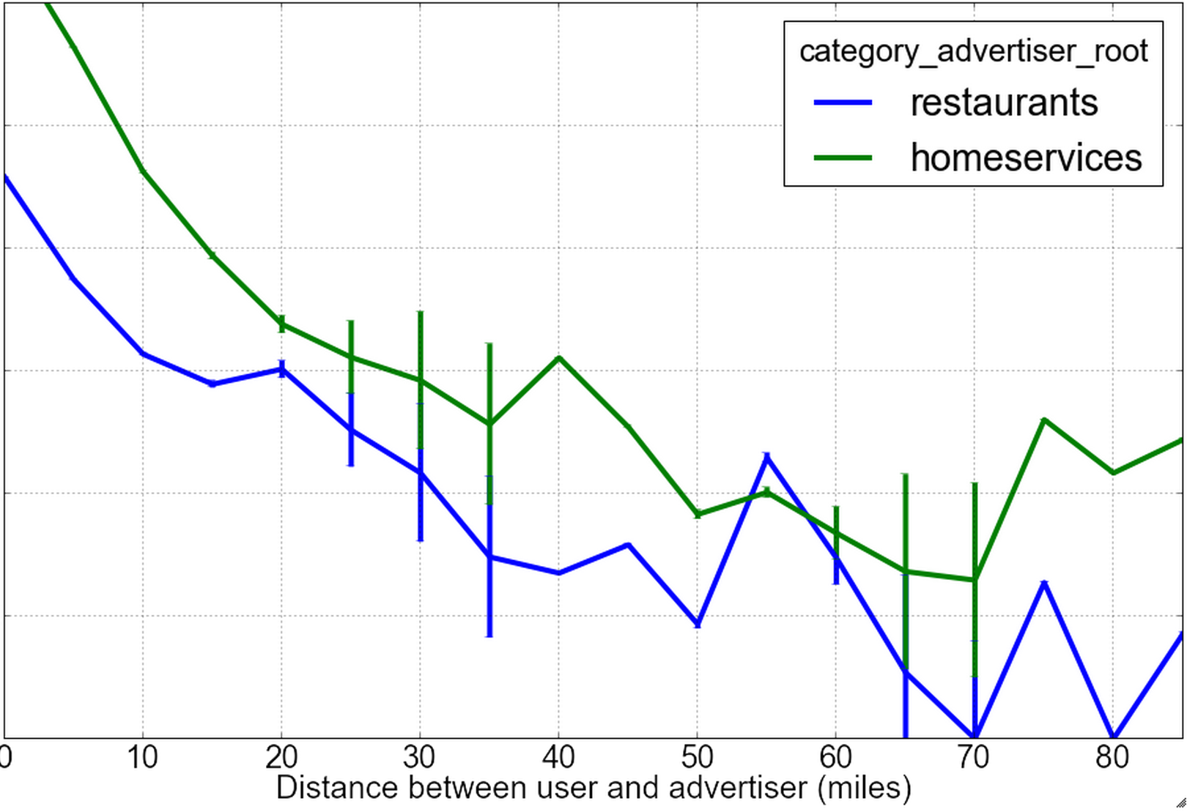
Uniqueness of Local Advertising - Location
Users interest in a business reduces with distance
Also varies by Category
Users are more sensitive to how close are restaurants
Users are less sensitive to how far is that plumber
CTR

Slide 5
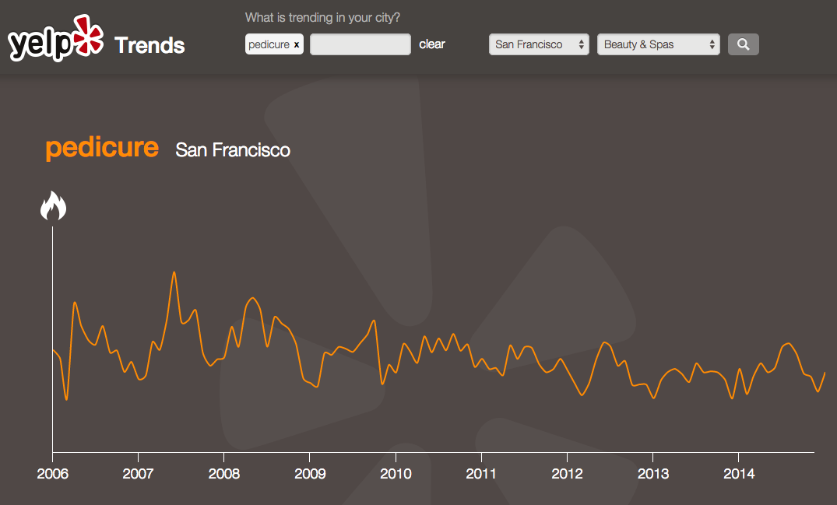
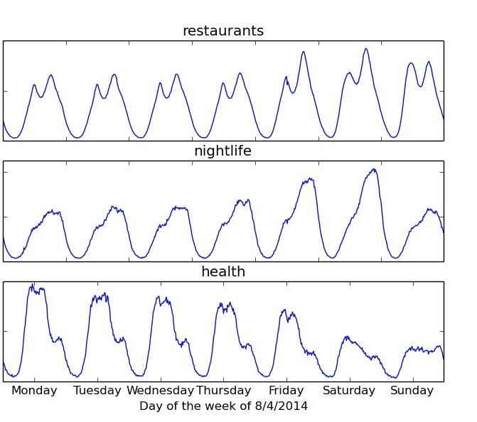
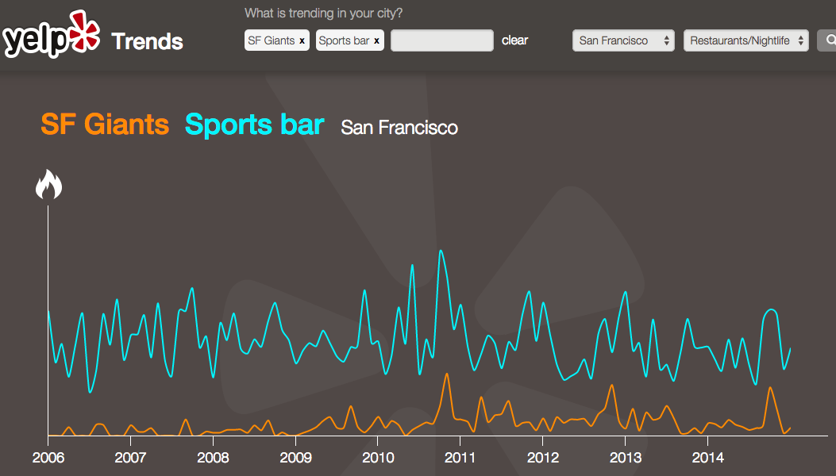
Local Advertising – Seasonal Effects
Seasonal Factors: Pedicure popular in Summer
Traffic varies by categories
Peak in summer
Day-factors: SF Giants Correlated with Sports bar
Correlated peaks
Notes:
y-many external factors:
Season-specific:
Start of school semesters implies higher demand for movers
Cold weather implies higher demand for HVAC Contractors

Slide 6
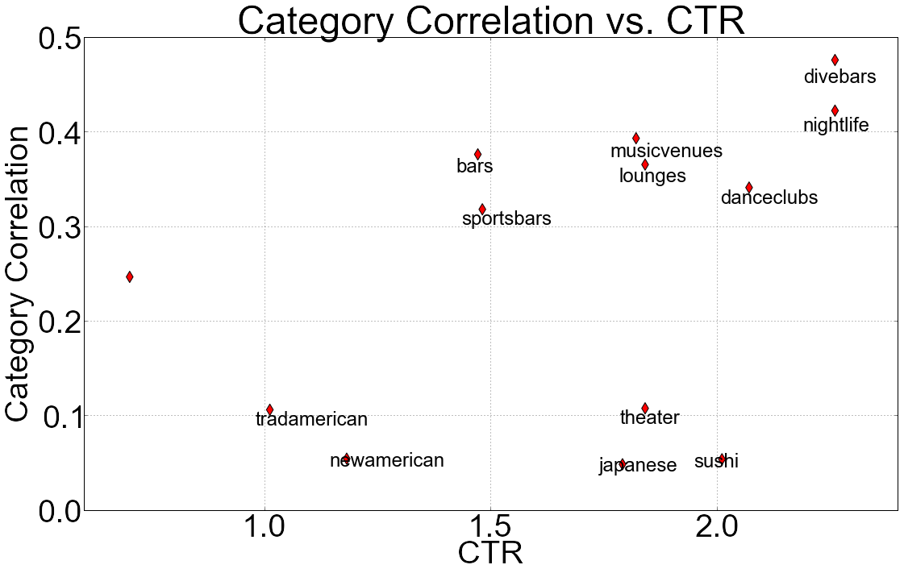
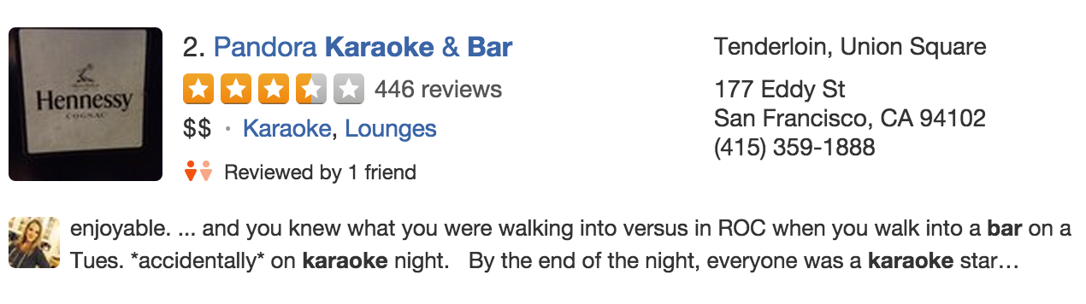

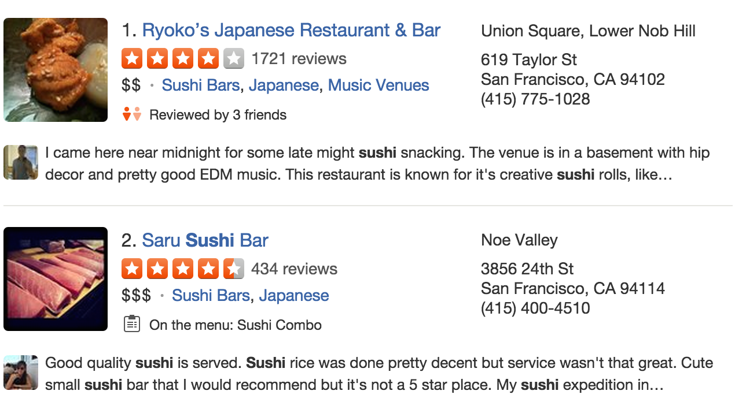
Uniqueness of Local Advertising - Categories
Karaoke ads do well on Sushi & Japanese searches
Queries where we show karaoke ads
Category Similarity
CTR
- Sushi has low “category similarity” to Karaoke
- But Karaoke ads do well on Sushi searches!

Slide 7
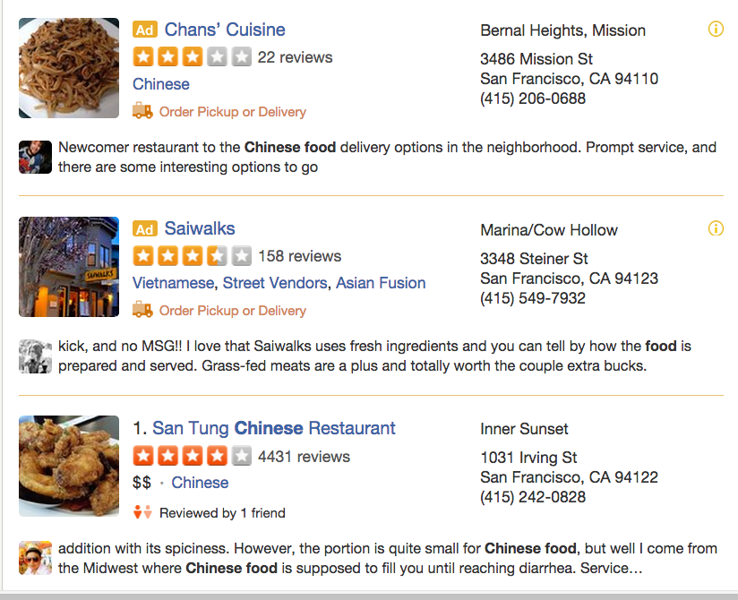
Uniqueness of Local Advertising - Budgets
If budget for Chinese advertisers “nearby” is exhausted
We may still show an ad for a closely-related category, e.g., Vietnamese
Notes:
Compared to search – ads has fewer chances to be right. Search has 10+ results, ads only 1 or 2. Hence category relevance is very important.

Slide 8

``Balancing all of the Stakeholders”
Within the fraction of a second that we return you “search results” for bars, we also return an ad that optimizes:
Relevance for user
Revenue for Yelp
Advertiser Goal (budget, clicks and leads)

Slide 9
Advertising is a “Matching Problem”
Constraints:
Finite Users (Opportunities/Traffic)
Finite Ad Budgets
Don’t know future traffic
Optimize:
Maximize Yelp Revenue
Show user “most relevant” ad
Fulfill Ad Budgets
Greedy strategy works well:
- Via 2nd price auction, Select ad with highest expected revenue
user
Page-view
Ad
user
Page-view
Ad
Time
user
Page-view
Ad

Slide 10
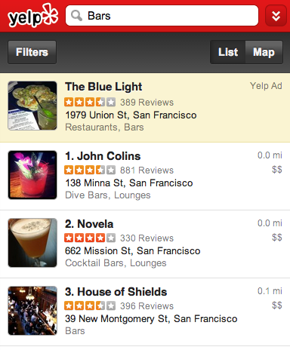
Ad Lifecycle
Blue Light, $100 budget
City Brewery, $200 budget
1) Candidate Ad Selection
2) Auto Bidder
Find best Bid price
for each ad
3) CTR Prediction
Click Probability for each ad
Ad | Cost-per-Click (cent) | Expected CTR: P(click) | Expected Revenue = CPC * CTR
Blue Light | 100 cents | 0.10 | 10 cents
City Brewery | 200 cents | 0.04 | 8 cents
If there’s a click, Blue Light pays:
8/0.10 = 80 cents
4) 2nd Price Auction

Slide 11
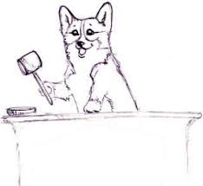
2nd Price Auction
Winner pays the runner-up’s price.
Dominant Strategy: bid your true value
If there’s a click, Blue Light pays: cents 8/0.10 = 80 cents
Ad | Cost-per-Click (cents) | Expected CTR: P(click) | Expected Revenue for Impression = CPC * CTR
Blue Light | 100 cents | 0.10 | 10 cents
City Brewery | 200 cents | 0.04 | 8 cents

Slide 12
1) Candidate Ad Selection
2) Auto Bidder
3) CTR Prediction
4) 2nd Price Auction

Slide 13
1) Candidate Ad Selection & Filtering Elastic Search – Index Ads and Search over them quickly
Elastic
Search
Index
Elastic
Search
Index
All
Ads
Location & Category Filters
ES query
All ads indexed by their geo-quad in Elastic Search
Notes:
Location-based query is resolved to find businesses within search-radius fairly quickly

Slide 14
1) Candidate Ad Selection & Filtering Elastic Search – Index Ads and Search over them quickly
Elastic
Search
Index
Elastic
Search
Index
All
Ads
Location & Category Filters
ES query
All ads indexed by their geo-quad in Elastic Search
CTR Prediction
Threshold Filters (CTR, ECPM)
Business Logic Filters
Ads in Auction
Auction
Notes:
Location-based query is resolved to find businesses within search-radius fairly quickly

Slide 15
1) Candidate Ad Selection
2) Auto Bidder
3) CTR Prediction
4) 2nd Price Auction

Slide 16

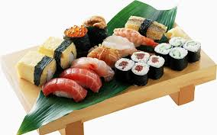
2) Auto-Bidding
Sushi chef just wants to optimize: Sushi, Sashimi & Nori
Doesn’t necessarily know how to optimize:
Cost Per Acquisition
Cost Per Click
Customer Lifetime Value (LTV)
Solution: They just set their monthly budget, we maximize clicks for their budget

Slide 17
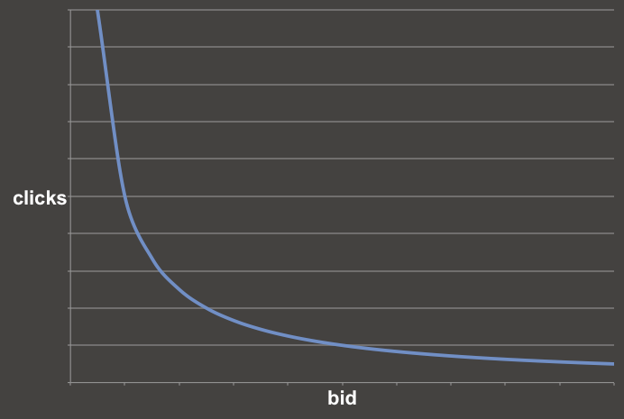
Can we bid for them?
for a given budget, how many clicks fit in that budget?

Slide 18
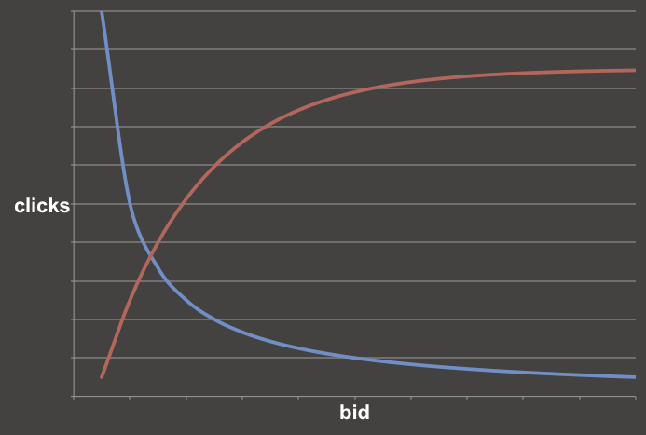
Can we bid for them?
given competition, how many auctions/clicks can be won?

Slide 19
Yes, we can bid for them!
most possible clicks given budget and competition - that’s the bid!
Notes:
Just the explanation we need for advertisers!

Slide 20
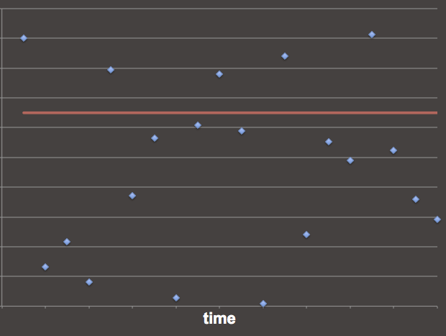
The “lowest price” clicks that
fulfill budget
Bid
Price
Notes:
If bid is set correctly, you’ll forgo expensive opportunities because better (cheaper) opportunities are coming later.

Slide 21
How do you find the intersection?
It’s easy to draw this line…
y = budget / bid

Slide 22
How do you find the intersection?
We can sample this line based on past auctions.
It’s easy to draw this line…
y = budget / bid

Slide 23
How do you find the intersection?
Repeat for each advertiser, assuming independence.
We can sample this line based on past auctions.
It’s easy to draw this line…
y = budget / bid

Slide 24
1) Candidate Ad Selection
2) Auto Bidder
3) CTR Prediction
4) 2nd Price Auction

Slide 25
3) Machine Learning based CTR Prediction
Train a Logistic Regression Model using Winners of our Auctions
Training Data:
Features about: User, Query & Ad Candidate
Prediction Variable: Click (1) or No-Click (0)
Methodology:
Training data: Impressions sampled over 1-3 months
Holdout Test data: Another sample typically 40% of the size of training data (minimally-overlapping with Training data)
Mean Cross Entropy (MXE): Lower is better
y log p + (1 – y) log (1 – p)
y = 1 (click), MXE = log p → 0 as p → 1
y = 0 (no-click), MXE = log (1 – p) → 0 as p → 0
Notes:
TODO: Add Sum

Slide 26
Complete System
dbs
training pipeline
ad_event
&
other logs
targeting sampling
batch
feature
extraction
training & model selection
model
Offline
ad_ctr_prediction package
scoring
data
features & extractor
config to model
model to config
Online
ad store
ad_delivery
model config
candidates

Slide 27
Feature Framework
Feature Extraction & Transformation
algorithm
Feature 1
Transforms
sparse vector
query &
ad
Feature 2
Transforms
pCTR
Feature n
Transforms:
Standardization
Distance, Distance^2
Model
Data:
- Historical CTR Table
Notes:
Historical CTR Table – obtained via MR job

Slide 28
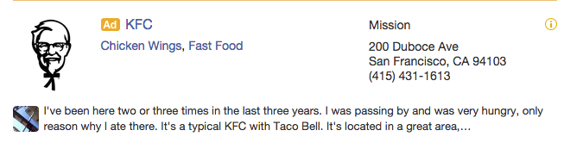
Feature Example
from ad_ctr_prediction.features.feature import Feature
from ad_ctr_prediction.features.feature import FeatureData
class BrandCampaignFeature(Feature): name = ’brand_name_campaign' def get_raw_feature(self, opportunity, candidate): """1.0 if brand advertiser, 0.0 otherwise""”
is_brand_name_campaign = 0.0
if candidate.is_brand_name_campaign:
is_brand_name_campaign = 1.0
return [FeatureData(value=is_brand_name_campaign)]

Slide 29
Model Training sklearn, Vowpal Wabbit & Spark
Sampled Training Dataset: Millions of impressions over last several months
Evaluation
5-fold CV with grid search over hyper-parameters (L1 vs. L2, etc.)
Re-evaluate on holdout dataset
Infrastructure
Extract features as spare scipy matrix with multiprocessing
Using sklearn SGD Classifier with multiprocessing
Scalable Solution:
Vowpal Wabbit
Apache Spark

Slide 30
Vowpal Wabbit + mrJob on EMR
Feature Extraction
EMR
Scalable
Extraction
Batch
S3
Training
Batch
Grid Search Point
Grid Search Point
Grid Search Point
Grid Search Point
Grid Search Point
EMR
EMR
EMR
EMR
EMR

Slide 31
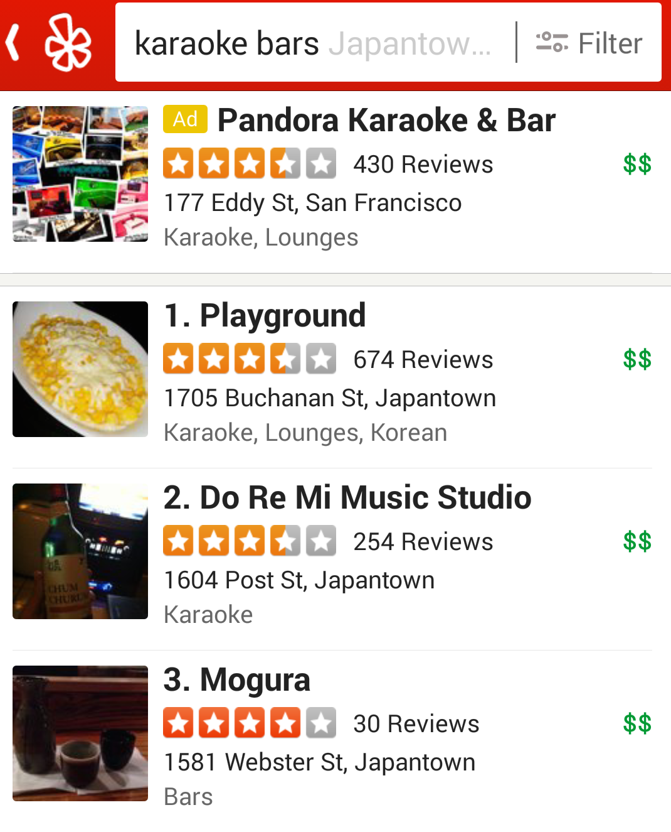
CTR Prediction Performance – Offline (or Training)
We train on only the winners of each auction
Past Shown Ads | Click or No-Click (y) | pCTR | MXE
 | Click (1) | 0.99 | Log(0.99)
 | No-Click (0) | 0.01 | Log(1-0.01)
Offline MXE =
y log pCTR + (1 – y) log (1 – pCTR)
Offline metric only measures how accurate our pCTR values are for the winners
Notes:
TODO: Add sum sign

Slide 32
CTR Prediction Performance – Online
During Online scoring: model actually evaluates every “candidate” for an auction
Ad Candidate for 1 Auction | pCTR | Bid
 | 0.99 | 10 cents
 | 0.01 | 8 cents
Online MXE =
y log pCTR + (1 – y) log (1 – pCTR)
Online MXE will also only measure performance for auction winners
Need Online metric that can measure performance of all auction participants!
Notes:
TODO: Add sum sign

Slide 33
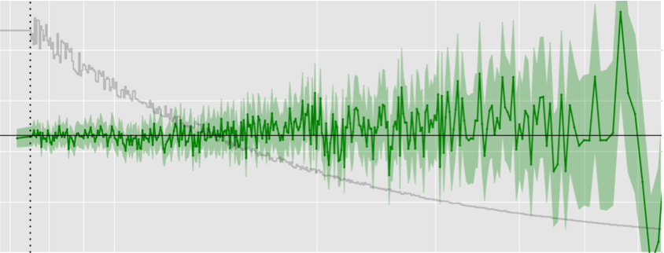
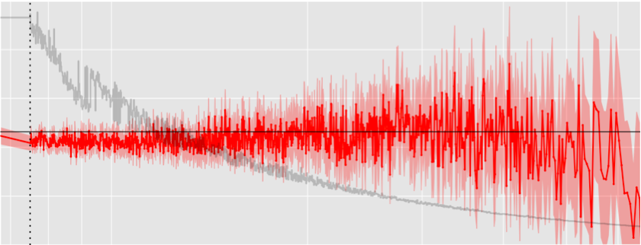
Online Performance: MXE vs. Calibration Metrics
Challenger Model: Worst by MXE but best by Calibration Metric
Impressions
oCTR - pCTR
Over-Prediction Errors:
oCTR < pCTR
pCTR bins
Status Quo: Best by MXE but worst by Calibration Metric
Impressions
oCTR - pCTR
pCTR bins
Notes:
TODO: Higher Resolution Pictures here

Slide 34
CTR Prediction Challenges
What’s a feature and what’s a model?
Page Type: Model
Advertiser Category: Feature
We want to use same model to evaluate all ad candidates
As this performs better in terms of ad-pick latencies
Training Frequency
High seasonality in our data

Slide 35
Revenue vs. Relevance
Low Relevance (Precision)
High Revenue (Recall)
Revenue
High Relevance (Precision)
Low Revenue (Recall)
Minimum pCTR Allowed in Auction
Measure of Relevance:
Clicks: 1st measure of relevance
Better indicator: Signals down the funnel
If ad was indeed irrelevant, users won’t look for directions to business, make a phone call, etc.
Crowd-sourced emails of bad ads (internal only)
Notes:
Naïve way to maximize Revenue: Show ads on every single search
We will likely show a lot of “irrelevant ads” then
Ideal goal: Maximize Revenue at a certain desired Relevance Level

Slide 36
Cost vs. Accuracy
Cost of a Feature:
Training cost: Time to train
Scoring cost: Time, CPU utilization & Memory needed in Ad-Servers
Cost increases with larger number of features
Object creation, Garbage Collection, etc.
Cost vs. Accuracy
Convert every category in our Category Tree in to a Binary Feature
Category:Japanese = 1
Category:Korean = 0
Convert: category feature to numerical via CTR translation
CategoryCTR = <float>
Notes:
TODO: Use table instead?

Slide 37
Model Training
Exploit/Explore:
Learn about “category pairs” we can expand into via exploit/explore strategies
Model Automation:
How to measure whether model started to get worse vs. traffic changed?

Slide 38
Conclusions
Local Advertising has lot of unique challenges
Yelp has several USPs for Local Business Advertisers:
Yelp users have a strong “intent to buy”
Yelp can “close the loop” for Local Business Advertisers
Optimize eye-balls or clicks to their Yelp page
Deeper Signals: Phone calls made from ads, Direction Lookups, etc.

Slide 39
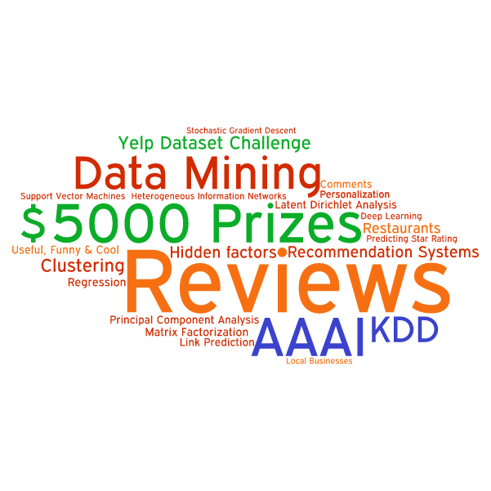
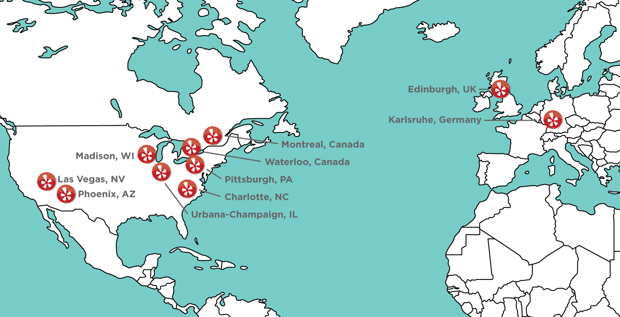
yelp.com/dataset_challenge
Your academic project, research or visualizations. Submitted by June 30, 2015.
All of Yelp data for 10 cities:
61K businesses
61K checkin-sets
481K business attributes
1.6M reviews
366K users
2.8M edge social-graph
495K tips

Slide 40
Q&A
Soups Ranjan, PhD
@soupsranjan
sranjan@yelp.com

